Slide 1

Module 7:
Refuting
Dualism

Slide 2
How do we refute Dualism?
The same way we do the others
The same 4 principles
we use for reasoning with unbelievers...

Slide 3

Problems to lookout for
1.) Opinions
and Self-Contradictions
2.) Unargued, privileged beliefs
3.) Sibling Rivalry
4.) Stealing from God

Slide 4

Recall these 3 as we analyze Dualism
Coherence
(not self-contradictory)
Explanatory power
(explains this world and the nature of humans)
Justification Force
(Good reason to believe it)
Notes:
There are 3 main pillars to critquing a worldview.
Let's go through Justification.
Explanatory power:
-Not unicorn (no justification)
Justification Force:
-"I don't like it" is not a justification.
Does "I don't like it"
provide the possibility
of logic, human dignity, and moral 'oughts'?

Slide 5

Dualism
Reality is:
-- Mind + Matter,
-- Spirit + Flesh,
-- The Material and the Immaterial.
There's right and wrong, but not the Christian view.
What you'll hear is...

Slide 6
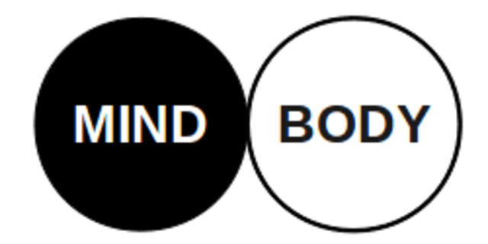
There's more to this world than matter.
There is good will.
Go after good vibes
Matter and Immaterial:
-- What is the relationship between the two?
-- How did they get married together?
-- One is eternal, the other isn’t.
-- Ideas, values, and logic are abstract. ***Not material.

Slide 7


Most people you run into are unsophisticated, 'spiritual' dualists who believe we should be good, and are involved in some form of synchrotism (a little of everything).
Stuff like this:
- karma
- previous lives
- must oppose tyranny
- the spirit of good will
- self-help
-spiritual

Slide 8

Confucious say?
That's his opinion. To know anything, we need the deity who created matter to reveal himself.
Confucious is a being who does
not have all knowledge
to tell us anything with certainty
We ask,
how does he know?
Dismissed – arbitrary
(no good reason to believe)
(lacks explanatory power)

Slide 9
Under what authority do you believe in your religion?
If man, its arbitrary because they are relying on human observation which is limited and self-refuting.
Human sense perception can only be verified with
more human sense perception.
Without revelation from one with all-knowledge, we are not justified to trust those senses.

Slide 10
Dualism is like
An airplane with no fuel
It can't even get off the ground

Slide 11
Logic and Hinduism
Every false worldview can be undermined in the same way
When someone comes with a different version fo God, you must ask how is logic + truth in morality possible
Hindus will tell you that distinctions are illusory and all is one
But if there is no distinction between you and me, no distinction between premises, and entites, which destroys the possibility of the laws of logic existing if Hinduism were true.

Slide 12

The foolishness of dualism
without the Christian God
-There is no basis for having
objective truth
It is reduced to opinion
because the source is human,
having finite, imperfect knowledge.

Slide 13

Next Module:
How to refute competing polytheistic worldviews

Slide 14

End of Module 7
Questions?

